Slide 1
Computer Evidence Collection & Investigation Process

Slide 2
Definition:
Computer forensics involves obtaining and analyzing digital information for use as evidence.
A responsive control
Where is this digital information captured from?
Computer storage media; Data in transit, etc

Slide 3
What is Possible with Computer Forensics?
Recovery of deleted data;
Discovery of when files were modified, created, deleted and organized;
What applications were installed; Which websites have been visited

Slide 4
What is Not Possible
If the digital media is completely (physically) destroyed, recovery is impossible;
If digital media is securely overwritten, recovery is very complicated or impossible.

Slide 5
When is Computer Forensics Needed?
Insurance Fraud;
Illegal software uses; Hacking;
Email misuse; Money laundering;
Destruction/altering of data; Intellectual property theft.

Slide 6
Purposes of Forensic Audit Process
Computer forensics is conducted for :three purposes
Investigating and analyzing computer systems as related to violation of laws.
Investigating and analyzing computer systems for compliance with an organization's policies.
Investigating computer systems that have been remotely attacked.

Slide 7
Digital Evidence
Digital evidence can be retrieved from computers, cell phones, pagers, PDAs, digital cameras, and any device that has memory or storage
Extremely susceptible to tampering

Slide 8
Standards of Digital Evidence
If evidence will be used in court proceedings or actions that could be challenged legally, evidence must meet these three standards:
Sufficiency: The evidence must be convincing or measure up without question
Competency: The evidence must be legally qualified and reliable
Relevancy: The evidence must be material to the case or have a bearing on the matter at hand.

Slide 9
Principles of Digital Evidence
Investigation/analysis performed on seized digital evidence should not change evidence in any form;
Evidence should only be manipulated and analyzed on a copy of original source;(cloning)
Individual must be forensically competent to be given permission to access original digital evidence;
Activity relating to seizure, access, storage, or transfer of digital evidence must be fully documented, preserved, and available for review

Slide 10
Identify & Labelling Evidence
Mark evidence properly as it is collected so that it can be identified as the particular piece of evidence gathered at the scene.
Label and store evidence properly.
Ensure that the labels cannot be removed easily.
Keep a logbook.
Identify each piece of evidence (in case the label is removed).

Slide 11
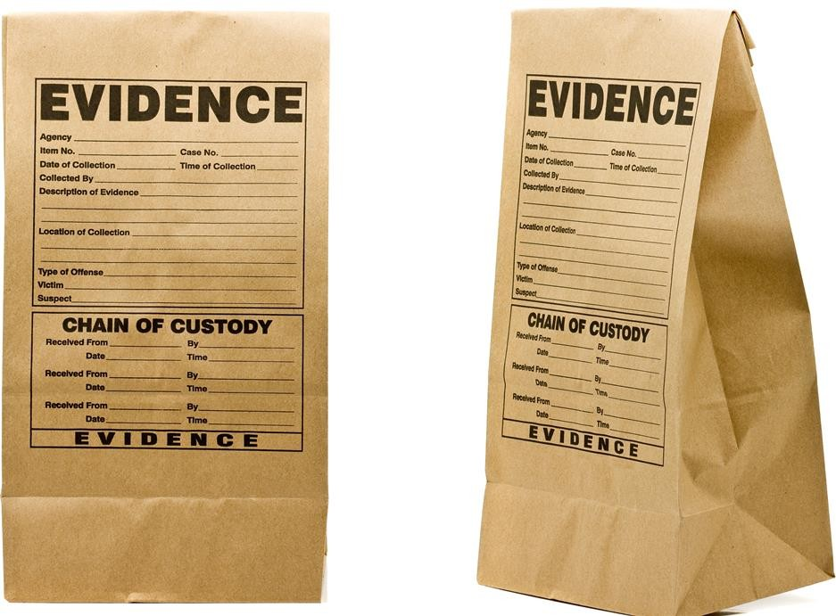
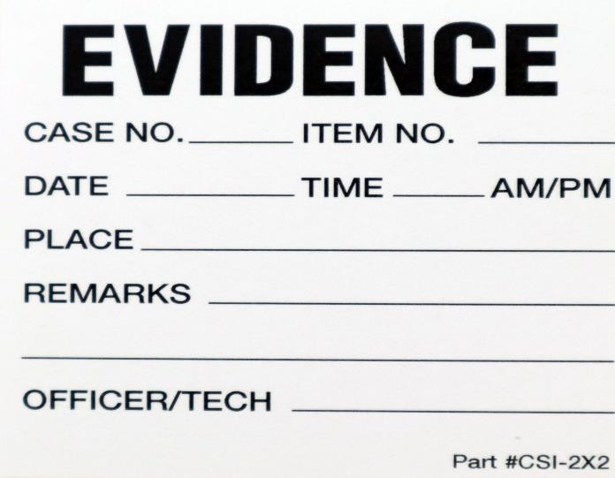
Identify & Labelling Evidence

Slide 12
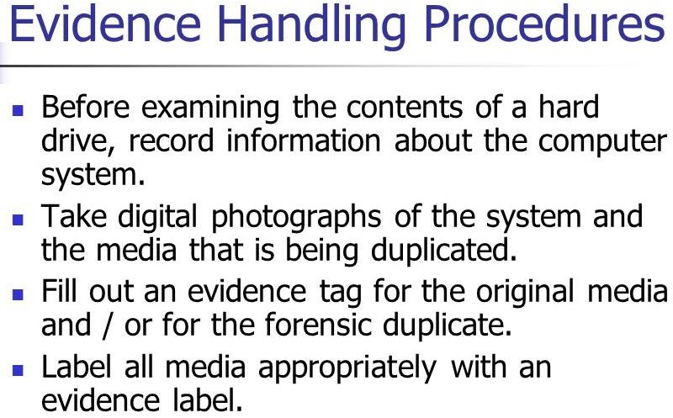

Slide 13
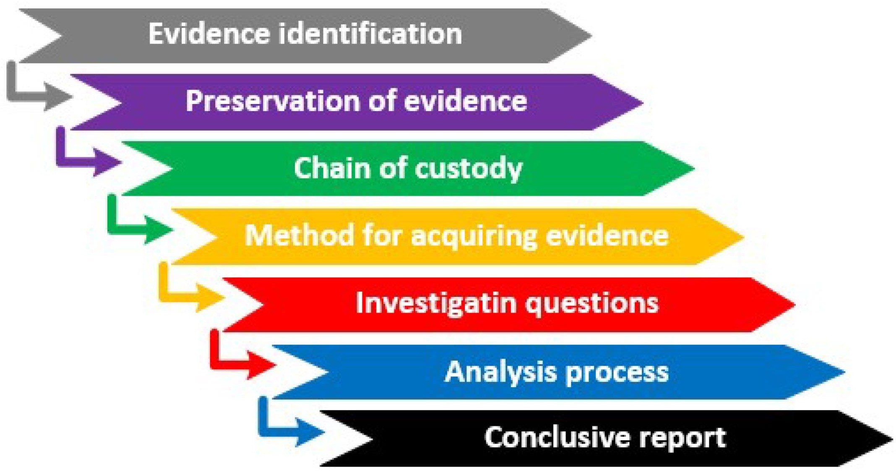
Evidence handling Procedure

Slide 14
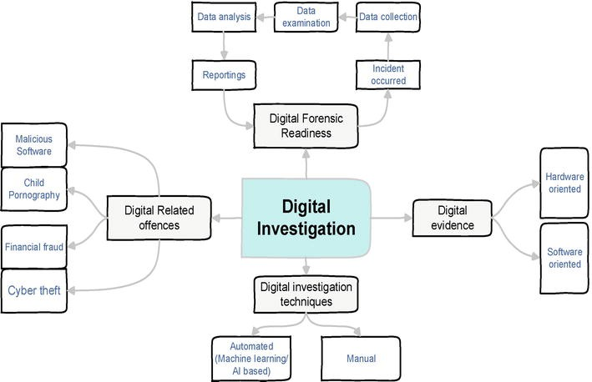
Forensic Investigation Using Machin Learning Approach

Slide 15
Identify Evidence (cont’d)
The information should be specific enough for Presentation later in the court.
Log other identifying marks, such as device make, model, serial number, and cable configuration or type.
Note any type of damage to the piece of evidence.
It is important to be methodical while identifying evidence.
Do not collect evidence by yourself—have a second person witness the actions.

Slide 16
Identify Evidence (cont’d)
Protect evidence from electromagnetic or mechanical damage (EMI, Radiations)
Ensure that the evidence is not tampered, damaged, or compromised by the procedures used during the investigation.
Do not damage evidence – Avoids liability problems later.
Protect evidence from extremes in heat and cold, humidity, water, magnetic fields, and vibration.
Use static-free evidence protection gloves, not standard latex gloves.
Seal the evidence in a proper container with evidence tape.

Slide 17


Static-free evidence protection gloves

Slide 18
Three rules of Evidence
Best Evidence Rule
Courts prefer original evidence rather than a copy to ensure no alteration of the evidence has occurred.
Exclusionary Rule
The Fourth Amendment to the United States Constitution precludes illegal search and seizure and, therefore, any evidence collected in violation of the Fourth Amendment is not admissible as evidence.
Hearsay Rule
Hearsay is second-hand evidence—evidence not gathered from the personal knowledge of the witness.

Slide 19
Guidelines for Collecting Evidence
While conducting the investigation, analyze computer storage carefully.
Analyze a copy of the system and not the original system – that is evidence.
Conduct analysis in a controlled environment with:
Strong physical security
Minimal traffic
Controlled access

Slide 20
Guidelines for Collecting Evidence
Unless there are specific tools to take forensic images under Windows, DOS should be used for imaging process instead of standard Windows.
Boot it from a floppy disk or a CD, and have only the minimal amount of software installed to preclude propagation of a virus or the inadvertent execution of a Trojan horse or other malicious program.
Windows can then be used to examine copies of the system.

Slide 21
Collecting Evidence
Each investigation is different. Given below is an example of a comprehensive investigation.
Remove or image only one component at a time.
Remove the hard disk and label it – use an anti-static or static- dissipative wristband and mat before beginning the investigation.(grounding oneself)
Identify the disk type (Integrated Drive Electronics (IDE),
Small Computer System Interface (SCSI)SATA, or other type).
Image the disk with a bit-level copy, sector by sector – this will
^{retain deleted files,}Pr^{e}ep^{t}a^{c}re.d By Alukwe Chris - CEH
21

Slide 22
Collection Steps
Proceed from more volatile assets to less:
Memory
Registry, routing table, arp cache, process cache
Network connections
Temporary files
Disk or storage device
Check processes running on the system
Copy arp cache, routing table, registry, status of network connections
Capture temporary files
Make byte-by-byte copy of entire media
Remove and store original media in a secure location
Do not run programs that modify files or their access times
Do not shutdown until the most volatile evidence has been collected
Do not trust programs on the system
Document the procedure
Prepared By Alukwe Chris - CEH 22

Slide 23
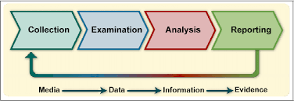
Chain of Custody
The chain of custody accounts for all persons who handled or had access to the evidence.
It shows who obtained the evidence, when and where it was obtained, where it was stored, and who had control or possession of the evidence.
Digital ForenPsreipcareCd BhyaAilnukwoefChCrisu- sCtEoHdy
23

Slide 24
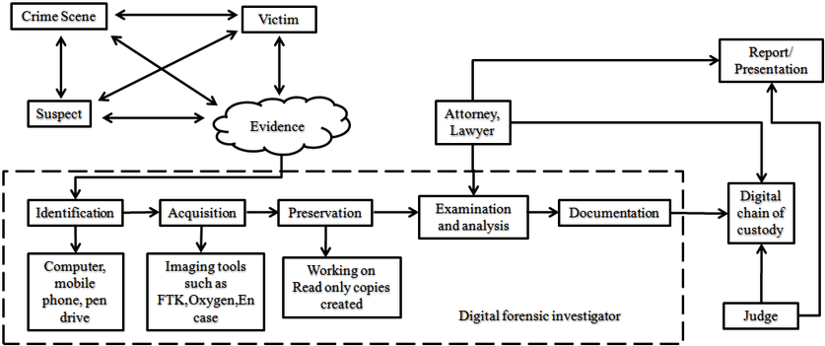
Relationship btwn Crime Scene & Chain of Custody

Slide 25
Chain of Custody (cont’d)
Steps in the chain of custody are:
Record each item collected as evidence.
Record who collected the evidence along with the date and time.
Document a description of the evidence.
Put the evidence in containers and tag the containers with the case number the name of the person who collected it, and the date and time.

Slide 26
Chain of Custody (cont’d)
Steps in the chain of custody are (continued):
Record all message digest (hash) values in the documentation.
Securely transport the evidence to a protected storage facility.
Obtain a signature from the person who accepts the evidence at this storage facility.
Provide controls to prevent access to and compromise of the evidence
while it is being stored.
Securely transport it to the court for proceedings.

Slide 27
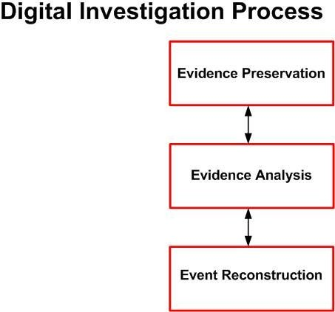
-> Media Acquisition
-> Answer questions
-> Ensure answers are correct to the extent possible
Full process recommended in forensics but may take short-cuts in some investigations, eg skip directly to evidence analysis on live system

Slide 28


Slide 29
Extra Notes for Personal reading
Internet Forensics Analysis: Profiling the Cybercriminal – Internet Protocols

Slide 30
Internet Protocols
Internet protocols are those rules allowing different operating systems and machines to communicate with one another over the Internet.

Slide 31

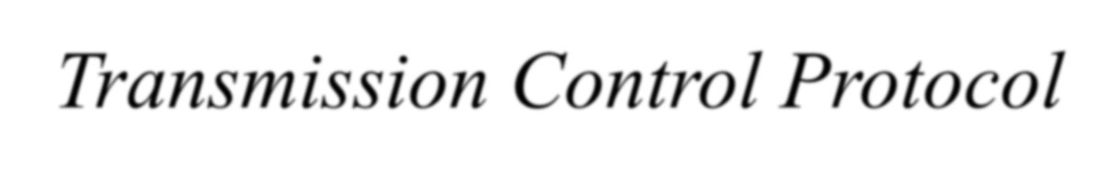

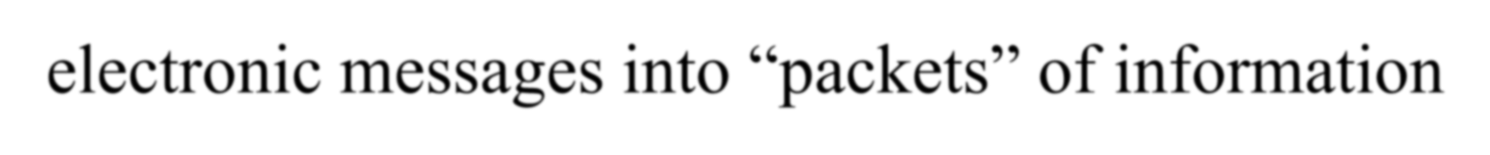

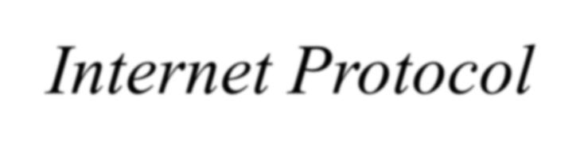


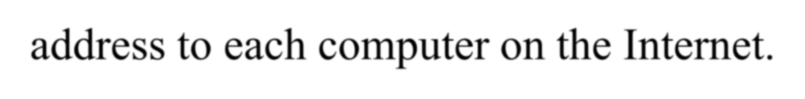
The Internet
Transmission Control Protocol (TCP) divides electronic messages into “packets” of information and then reassembles these packets at the end.
Internet Protocol (IP) assigns a unique address to each computer on the Internet.

Slide 32
Transmission Control Protocol (TCP) and Internet Protocol (IP)
TCP/IP protocols are the communication guidelines used and
widely supported over the Internet.
Almost every packet of information sent over the Internet uses the datagrams contained within a TCP/IP envelope. The datagrams consist of layers of information needed to verify the packet and get the information from the sender’s to the receiver’s location following traffic control guidelines.

Slide 33
OSI Model
Data unit
Layer
Function
Application
Network process to application
Data
Presentation
Data representation and encryption
Host layers
Session
Interhost communication
Segments
Transport
End-to-end connections and reliability (TCP)
Packets
Network
Path determination and logical addressing (IP)
Media layers
Frames
Data link
Physical addressing (MAC & LLC)
Bits
Physica^{P}l^{repared By Al}M^{uk}e^{w}d^{e}ia^{C}, ^{h}s^{r}ig^{is}n⁻a^{C}l a^{E}n^{H}d binary transmission
33

Slide 34
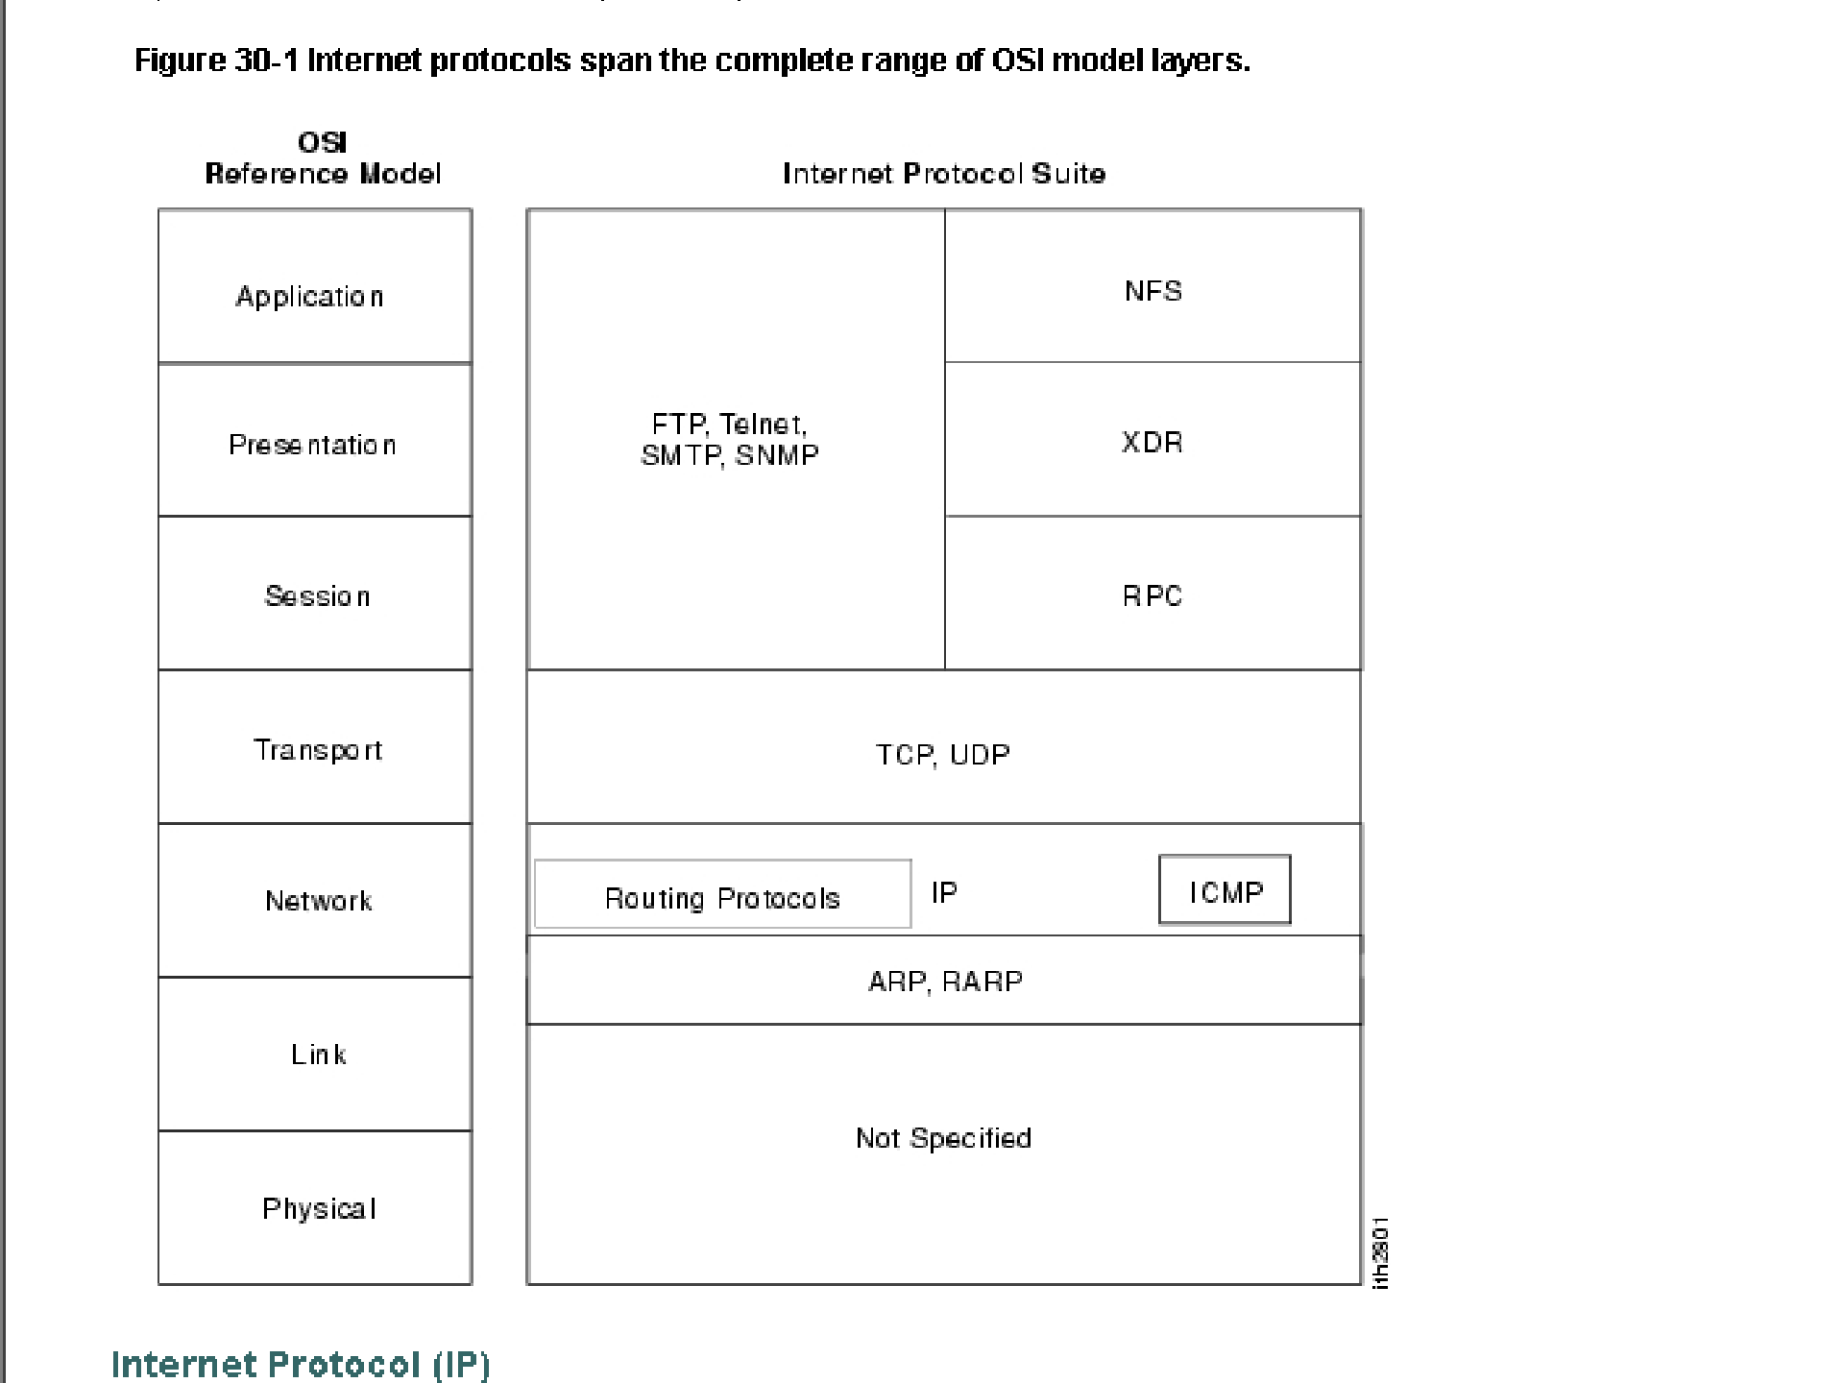

Slide 35
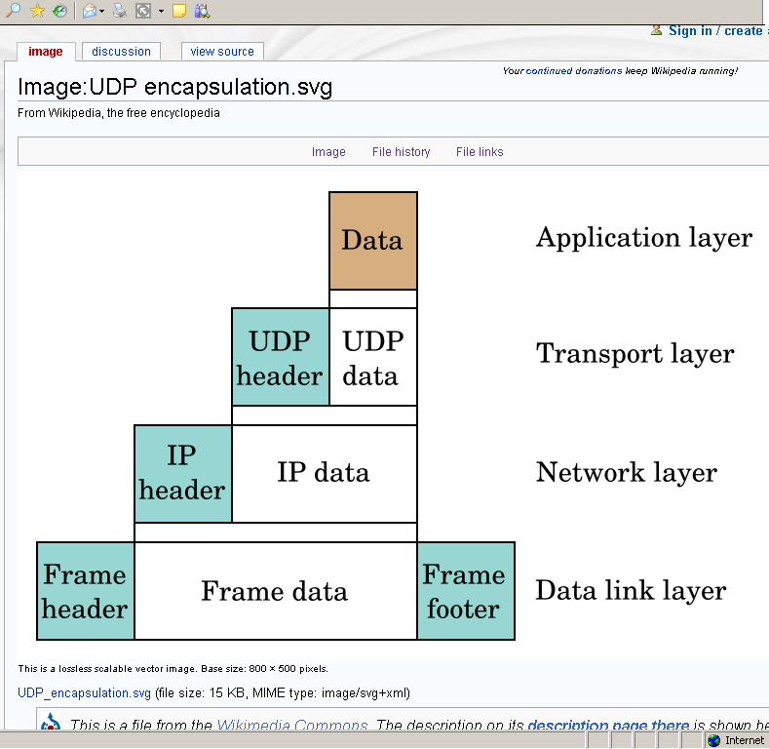

Slide 36
TCP/IP Connections
A three-way handshake synchronizes both ends of a connection by allowing both sides to agree upon initial sequence numbers. This mechanism also guarantees that both sides are ready to transmit data and know that the other side is ready to transmit as well.
SYN → SYN/ACK → ACK → FIN

Slide 37
Popular Protocols
DNS: The Domain Name System
Finger: Used to determine the status of other hosts and/or users
FTP: The File Transfer Protocol allows a user to transfer files between local and remote host computers
HTTP: The Hypertext Transfer Protocol is the basis for
exchange of information over the World Wide Web

Slide 38
Popular Protocols
IMAP: The Internet Mail Access Protocol defines an alternative to POP as the interface between a user's mail client software and an e-mail server, used to download mail from the server to the client
Ping: A utility that allows a user at one system to determine the status of other hosts and the latency in getting a message
POP: The Post Office Protocol defines a simple interface
between a user's mail client software and an e-mail server

Slide 39
Popular Protocols
SSH: The Secure Shell is a protocol that allows remote logon to a host across the Internet
SMTP: The Simple Mail Transfer Protocol is the standard protocol for the exchange of electronic mail over the Internet
SNMP: The Simple Network Management Protocol defines procedures and management information databases for managing TCP/IP-based network devices
Telnet: Short for Telecommunication Network, a virtual terminal protocol allowing a user logged on to one TCP/IP host to access other hosts

Slide 40
Web Log Entries
One important method for finding the web trail of an attacker is in examining web logs.
Recorded network logs provide information needed to trace all website usage.
Web Log = Blog
Also check transaction logs and server logs

Slide 41
Web Log Entries
Information provided in a log includes the visitor’s IP address, geographical location, the actions the visitor performs on the site, browser type, time on page, and the site the visitor used before arriving.
Logs should be stored on a separate computer from the web server hosting the site so they cannot be easily altered.

Slide 42
TCPDUMP
TCPDUMP is a form of network sniffer that can disclose most of the information contained in a TCP/IP packet.
Windows uses WinDUMP
A sniffer is a program used to secretly capture datagrams moving across a network and disclose the information contained in the datagram’s network protocols.

Slide 43
Decoding Simple Mail Transfer Protocol (SMTP)
SMTP is the protocol used to send e-mail over the Internet.
SMTP server logs can be used to check the path of the e-mail from the sending host to the receiving host.

Slide 44
Decoding Simple Mail Transfer Protocol (SMTP)
Most of the important information about the origin of an e- mail message is in the long form of the header. The most important data for tracing purposes is the IP addresses and the message ID.

Slide 45
Tracing and Decoding IP Addresses
Traceroute
Whois
Ping
Finger searches

Slide 46
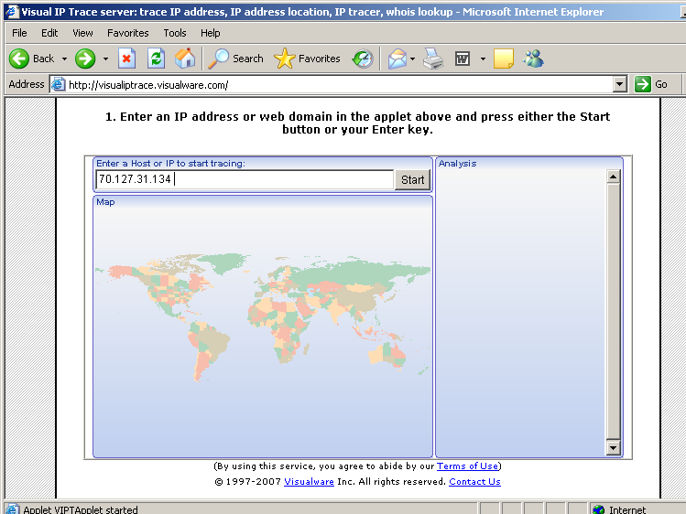

Slide 47
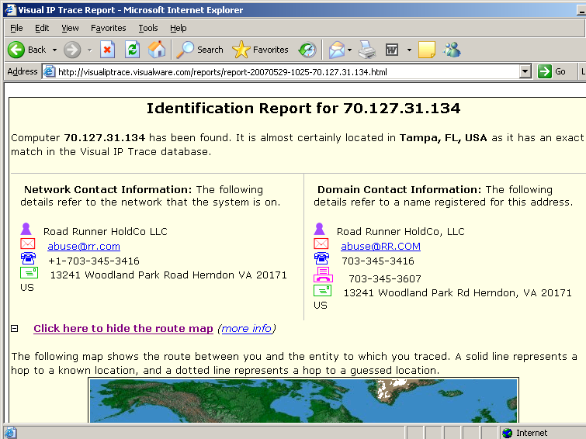

Slide 48
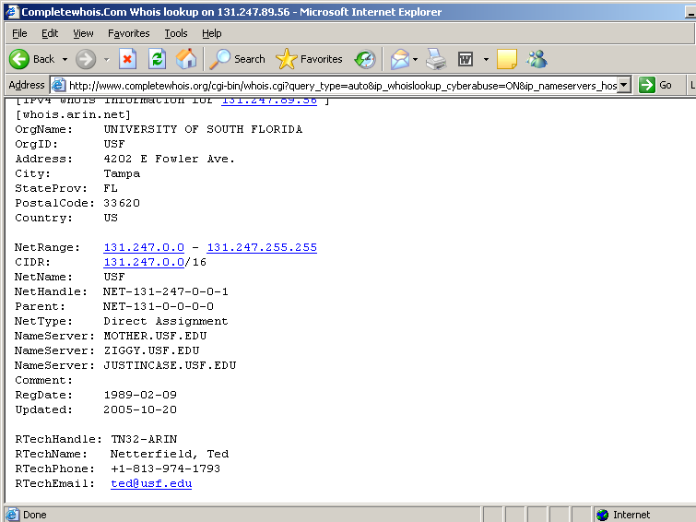

Slide 49
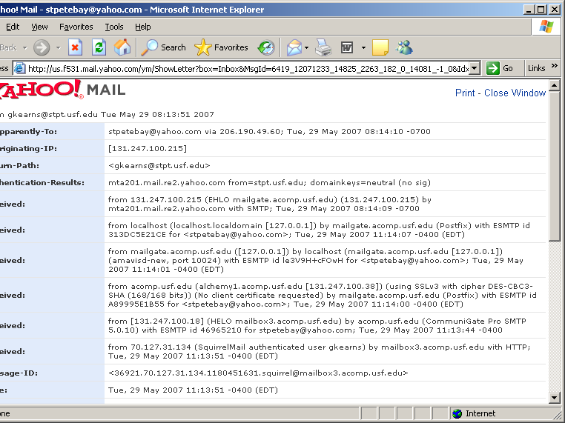

Slide 50
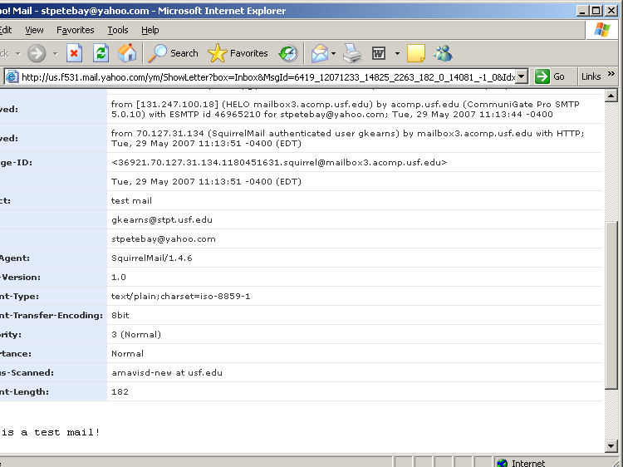

Slide 51
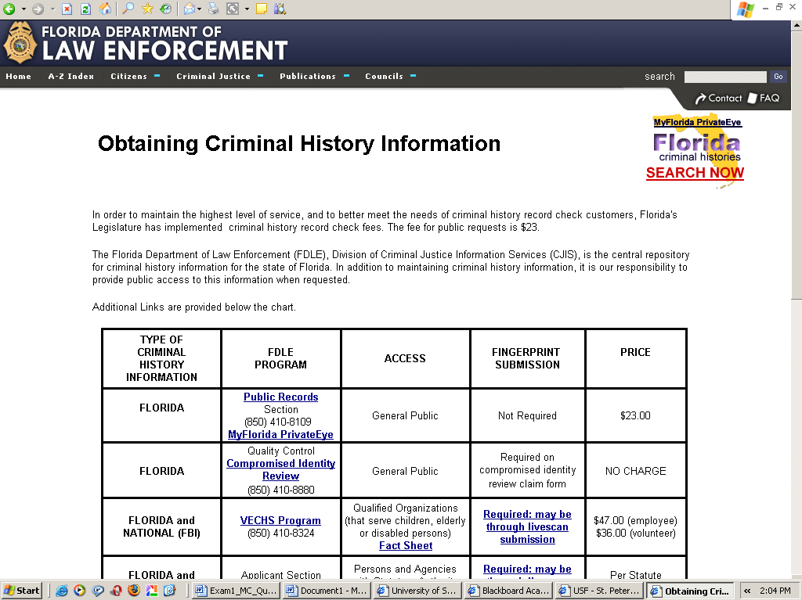
70

Slide 52
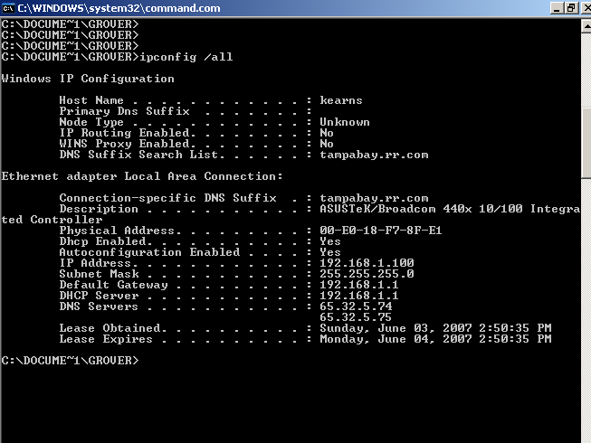
ipconfig /all

Slide 53
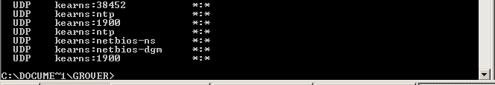

Slide 54
Initial Response

Slide 55
Off-scene Response
Freeze the Incident Scene
Verbally contain the scene with instructions such as:
“Take your hands off the keyboard and step away from the computer.”
“Physically disconnect the computer from the network.”
“What is your name, office and telephone number.”
“What is the hardware and operating system?”
“I’m going to fax you a set of instruction. What is your Fax number?”

Slide 56



Incident Response Checklist
Version 1.0
Date:
Time:
Name:
Telephone Number:
Nature of Incident:
Time of Incident:
How was the incident detected:
Current Impact of Incident:
Future Impact of incident:
Description of the incident:
Hardware/OS/Software involved:
IP and network addresses of compromised systems: Network Type:
Modem:
Criticality of Information:
Physical location:
System Administrator Name and Number: Current status of machine:
Description of Hacker Actions
Ongoing activity:
Source Address:
Malicious program involved:
Denial of Service Vandalism:
Indication of insider or outsidPerre:pared By Alukwe Chris - CEH
56

Slide 57

Incident Response Checklist Continued
Version 1.0
Client Actions
Network disconnected:
Remote access available:
Local Access available:
Audit logs available and examined: Any changes to firewall:
Any changes to ACL:
Who has been notified:
Other actins taken:
Available Tools
Third party host auditing: Network monitoring:
Network Auditing:
Additional Contacts
Users:
System Administrators:
Network Administrators:
Special Information
Who should not know about this incident:
Response Team Member SignatPurreep/aDreadteB:y Alukwe Chris - CEH
57

Slide 58


Incident Response Team Fax
Version 1.0
Date:
Time:
Name:
Thank you for notifying the incident response team and agreeing to help. Please do not touch the affected computer(s) unless told to do so by a member of the Incident Response team. Please remain within sight of the computer until a member of the Incident Response Team arrives and assure that no one touches the computer.
Please help us by detailing as much information about the incident as possible. Please complete
the following items. If additional space is required use a separate sheet of paper.
Witnesses:
1.
2.
3.
What indicators lead you to notice and/or report the incident. Be as specific as possible.
Incident Indicators:
The next section is important so be as accurate as possible. From the time you noticed the incident to the time you took your hands from the computer, list every command you typed and any file you accessed.
Commands typed and Files accessed:
Prepared By Alukwe Chris - CEH
58
Response Team Member Signature: -

Slide 59
On-scene Response
Physically contain the scene
Two personnel, if possible, should immediately respond to the scene
Incident Scene Survey (1st Member)
Use a portable tape recorder to:
Record the scene
Everyone present
» Order everyone to leave the scene who is not directly involved in the incident
Interview the individual who reported the incident
Record, intermittently, the actions of the 2nd individual
Assist the 2nd Member

Slide 60
On-Scene Response Continued
Contain the System (2nd Member)
Ask the System Administrator to assist.
Back up the system.
» Do this with forensic type tool that does bit-by-bit backup such as SafeBack at http://www.forensics- intl.com
» Alternatively, remove the drive and seal it in a plastic bag with your notes and the notes of the individual who reported the incident
Attempt to identify the changed files through:
» Tripwire http://www.tripwire.org/ or alternatively
» Expert Witness at http://www.asrdata.com.

Slide 61
Knowing Architecture and Policies
Review Network Topology
External connectivity
Internet
Extranet
Dial-up
Remote Sites
Network Devices: Routers, Firewall, IDS
Broadcast domains
Review the Corporate Policies with regard to
Acceptable use policies
Network Monitoring
^{Computer Forensi}P^{c}re^{s}pared By Alukwe Chris - CEH
61

Slide 62
Conducting Personnel Interviews
System administrator selected questions include:
Unusual Activity?
Administrative Access to System?.
Remote Access to Systems?
Logging Capabilities?
Current Security Precautions?
Managers selected questions include:
On-going Security tests?
Disgruntled employees?
Recently fired employee?
History of current employees?
Sensitive data or applications on the systems?
End users selected questions include:
Anomalous Behavior or Suspicious activity?

Slide 63
Initial Assessment
Assess the potential security Incident
What are the incident symptoms?
Is it a security incident?
A system problem?
Power outage
Faulty software
Communication problems
Procedural problem
Training Problem

Slide 64
Initial Evaluation
Evaluate the severity & scope of incident
What specifically happened?
What was the entry point?
What local computers/networks were affected?
What remote computers/networks were affected?
What information was affected?
What was its value to the organization?
What further can possibly occur?
Who else knows about the incident?
What are the estimated time/resources required to handle the incident.

Slide 65
Incident Indications
A new account
Passwords were changed on existing accounts
The protection changed on selected files/devices
System programs have been added/modified
An alias has been installed in the E-Mail system to run a program
New features have been added to your news
Password sniffer was found (Steal passwords to use Crack)
File dates have been modified
Login files have been modified
The system has an unexplained crash
Accounting discrepancies
Denial of Service
Unexplained poor system performance
Suspicious probes/browsing

Slide 66
Incident Indications (cont’d)
Undocumented changes or upgrades to programs
Unexplained user account charges or changes
Security Access compromise (passwords, etc)
Unauthorized use of computer facilities
Unexplained network/computer crashes
Unexplained corrupted files or services
Theft/missing computer/storage equipment
Unexplained Performance/response problems
Unexplained High utilization of equipment, storage or network resources
Unexplained loss of critical/sensitive data
Unexplained user account lockouts
Unexplained Network traps/alarms
Unexplained Firewall/IDS alerts/alarms

Slide 67
Initial Steps
All systems/networks are suspect until the actual extent of the incident is known
Verify integrity of all site computers
Verify integrity of all site networks
Verify integrity of all files/directories (checksums)
Compare system files with backups or initial distributions
Compare software application with the baseline
Analyze the documentation, files and security logs
Be careful not to contaminate the crime scene

Slide 68
Forensics Terminology
Evidence Media: Original media that needs to be investigated
Target Media: the media that the evidence media is duplicated onto
Restored Image: Copy of the forensic image restored to bootable form
Native Operating System: OS utilized when the evidence media or forensic duplicate is booted for analysis
Live Analysis: A analysis conducted on the original evidence media
Off-line Analysis: Analysis conducted on the forensic image
Trace Evidence: Fragments of information from the free space, etc.

Slide 69
Common evidence mistakes
These include include:
Altering time and date stamps
Killing rogue processes
Patching the system before the investigation
Not recording commands executed on the system
Using un-trusted commands and binaries
Writing over potential evidence:
Installing software on the evidence media
Running program that store output on evidence media.

